Slide 1

Study the Coulomb breakup of ⁷Li into alpha+t:
Potential model for t(α,γ)⁷Li
S-factor calculations
Eki González Flamarique

Slide 2
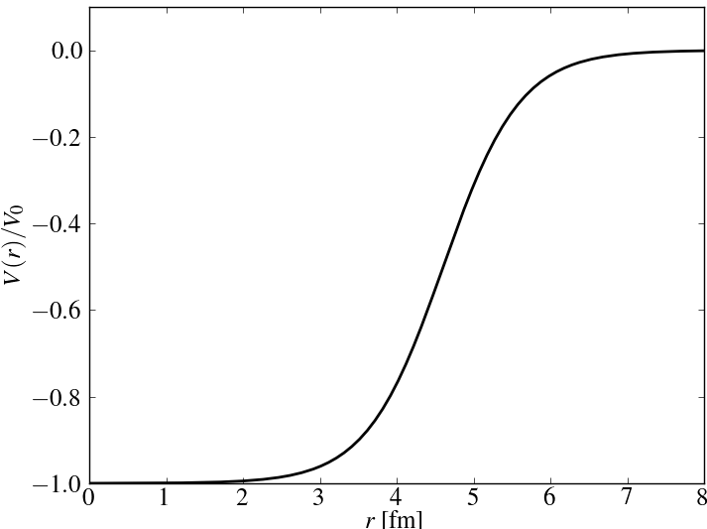
Two cluster model ⁷Li with Woods-Saxon potential
⁷Li
Model strong force by Woods-Saxon potential
α
r
t
E ψ(r) = -ħ²/2m ∇²ψ(r) + V(r)ψ(r)
Spherical symmetry → |n l j m〉→ partial waves
Transitions: from continuum to bound states

Slide 3

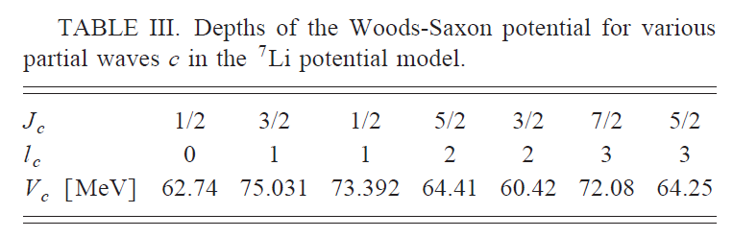
Starting point: Literature review
Find experimental measurements of cross-section
Search for a potential model to describe ⁷Li as α+t
Reproduce papers results by Fortran codes.
Tokimoto

Slide 4
Name | Year | Energy range, Ecm | Method | Target | Beam intensity
Holmgren | 1958 | 450 < E < 1350 keV | Direct | 3H and 3He gases | 0.2 or 0.3 ua alpha
Griffiths | 1961 | 0.35 < E < 1.83 MeV | Direct | Tritium targets absorbed in thin evaporated layers of Zr on Pt backings. | ¿?
Burzynski | 1987 | 280 < E < 900 keV | Direct | T-Ti targets | up to 15 uA alpha
Schröder | 1987 | 50 < E < 480 keV | Direct | Ti3H about 20 mu-g/cm2 thick a Cu backing | alpha particle currents of 2-13 uA
Utsunomiya | 1990 | 80 < E < 980 keV | Indirect by breakup | 27Al - 208Pb | 42 - 63 MeV – 7Li
Brune | 1994 | 50 < E < 1200 keV | Direct | Ti-3H | 20 nA—30 uA alpha particles
Tokimoto | 2001 | 100 < E < 500 keV | Coulomb breakup | 27Al - 197Au | 42 MeV– 7Li 30–300 nA
Bystritsky | 2016 | 15.7 keV = E | Direct | titanium tritide TiT | ~ 5 × 10^14 4He+ ions per pulse

Slide 5
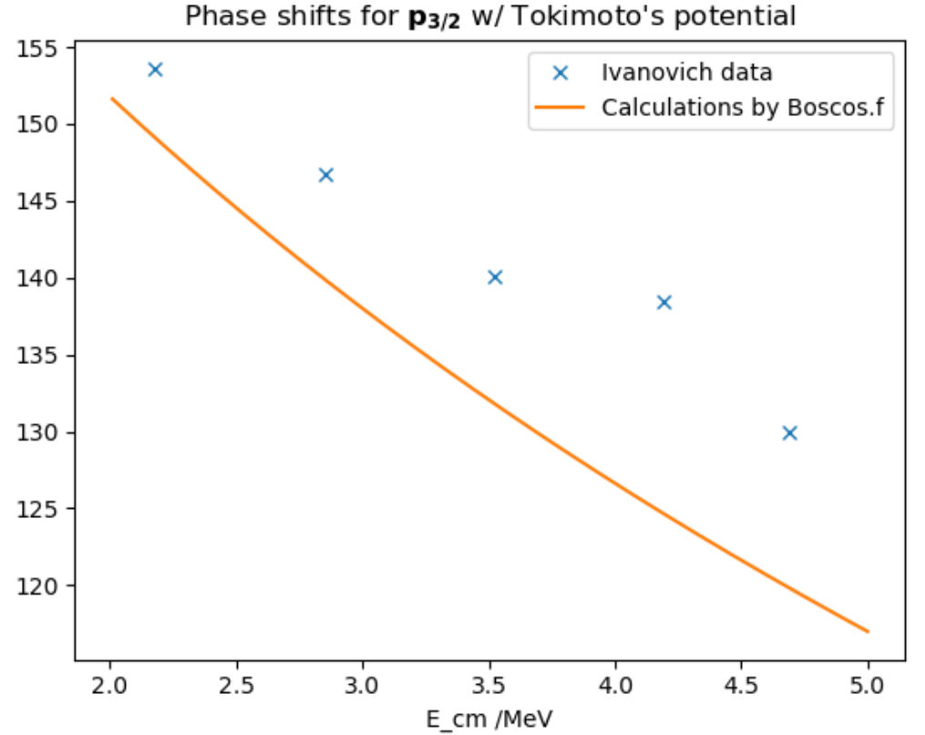
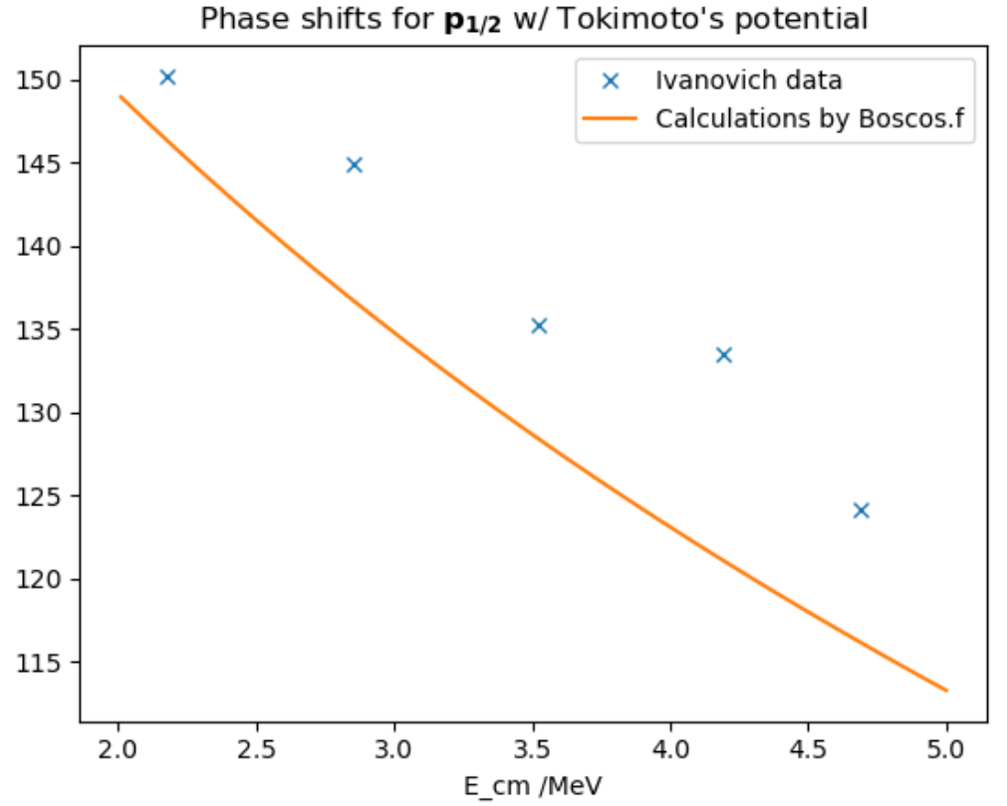
Try to reproduce Tokimoto’s results for bound states
— 2.50
2.467 — — — —
Varying mass and radius parameters, phase-shifts and binding energy results are significantly off → REFIT IS NEEDED.
— 2.40
2.366 —
— 2.30
— 2.20
2.135 —
— 2.10
E /MeV

Slide 6
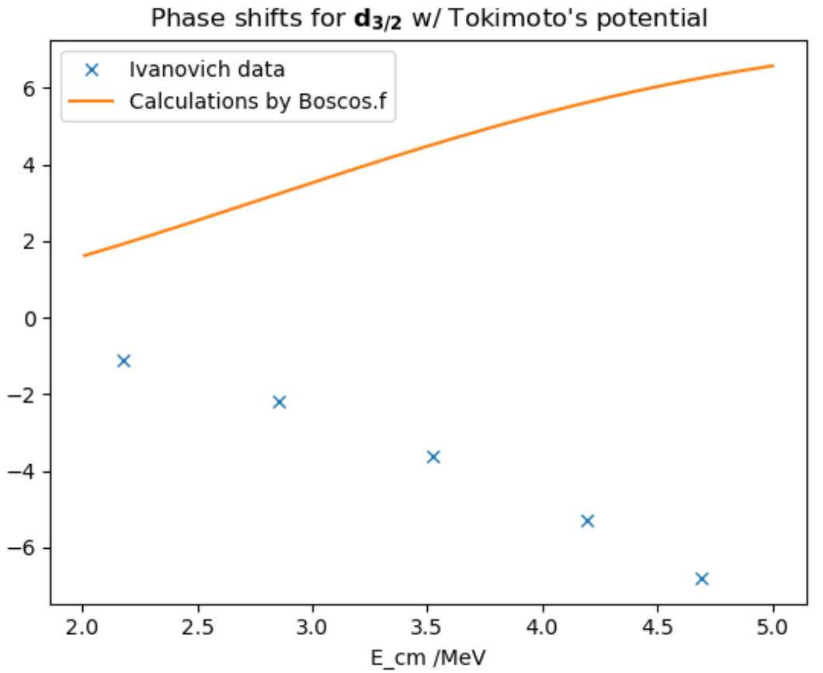
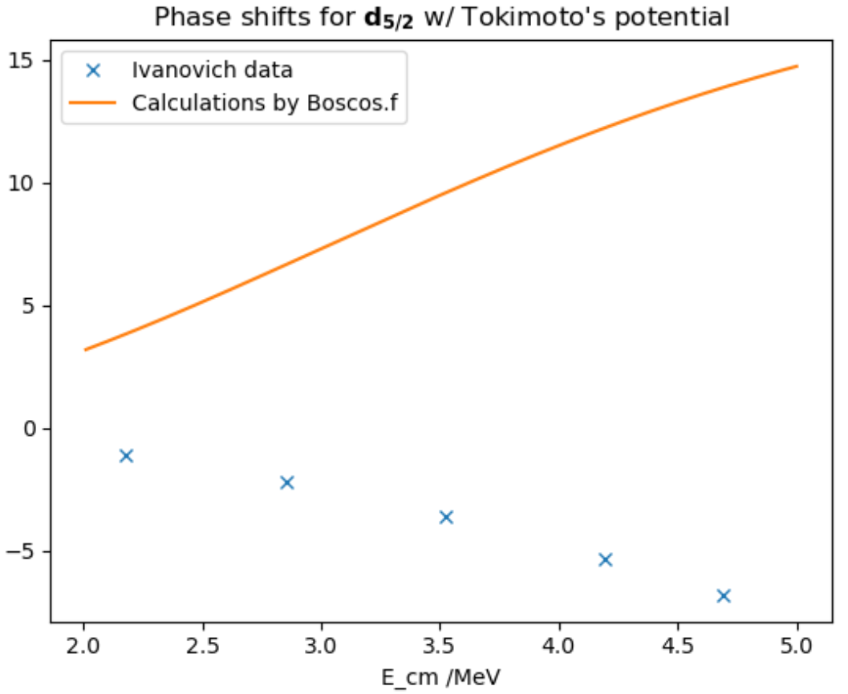
Try to reproduce Tokimoto’s results for continuum states
For d-waves, results phase-shifts results are completely off.
→ REFIT IS NEEDED.

Slide 7
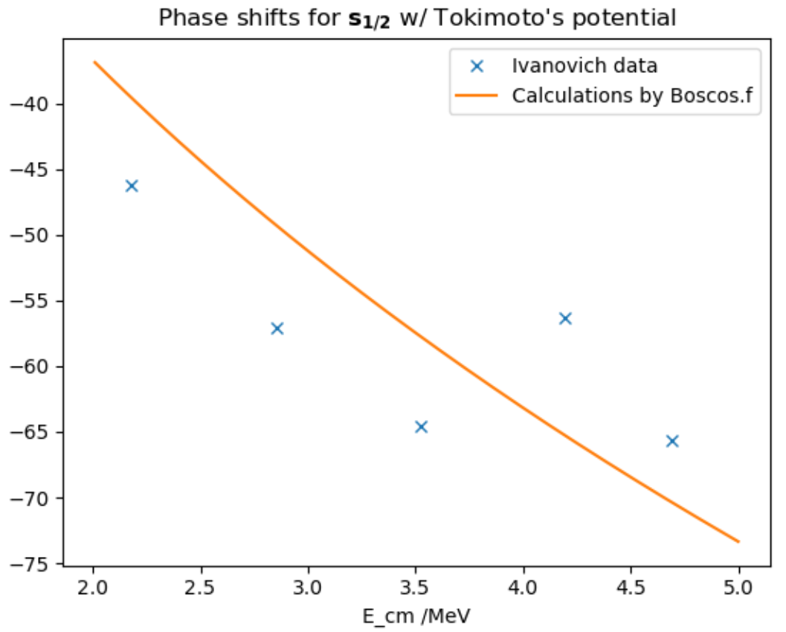
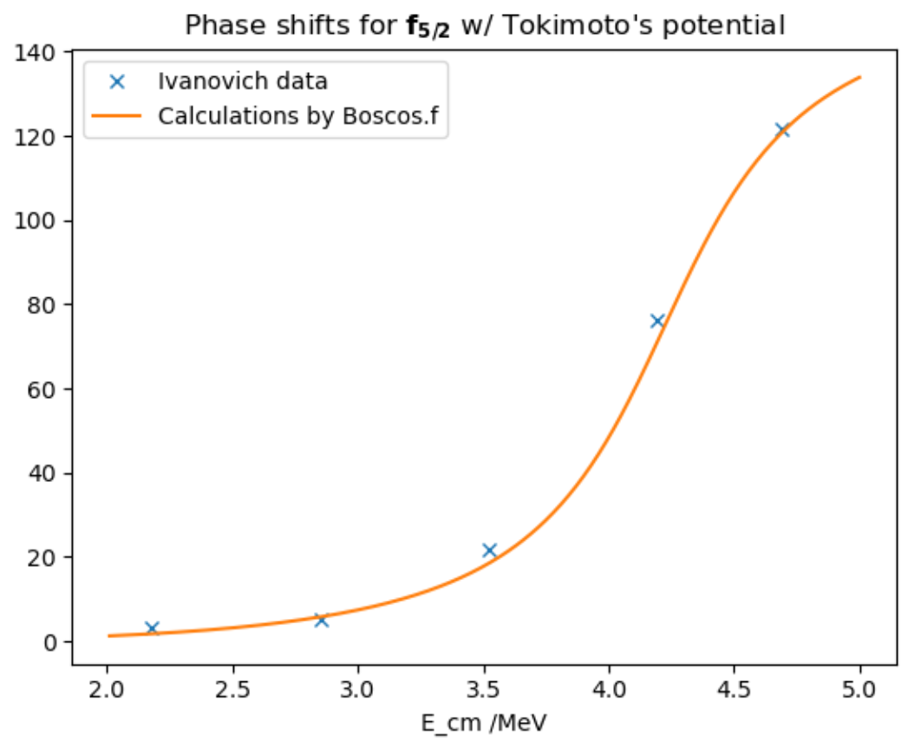
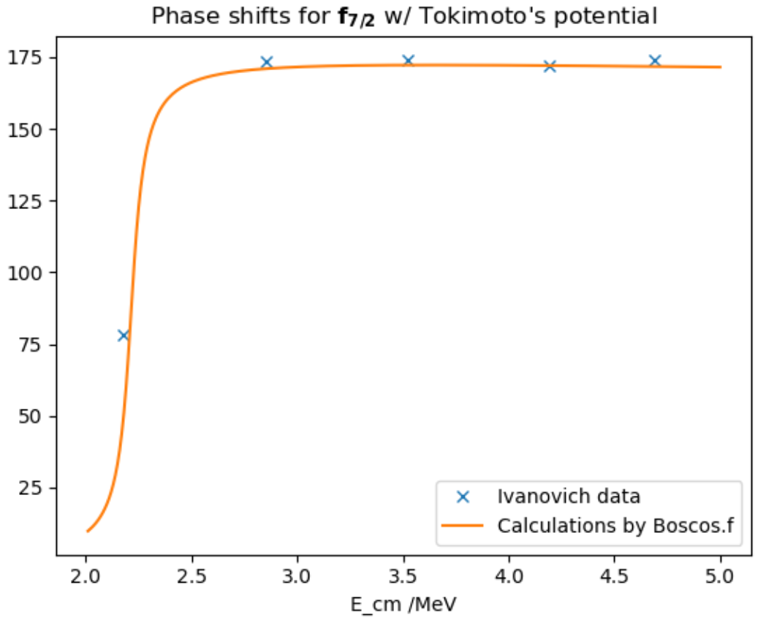
Try to reproduce Tokimoto’s results for continuum states
For s-wave and f-waves, results phase-shifts results are good.

Slide 8
Correct by refitting Tokimoto’s model
For s-wave and f-waves we will use Tokimoto’s parameters.
Refit p-waves’ parameters to experimental binding energy.
Refit d-waves’ parameters to phase-shift data.
Adjust method are usual bisection and secant.

Slide 9
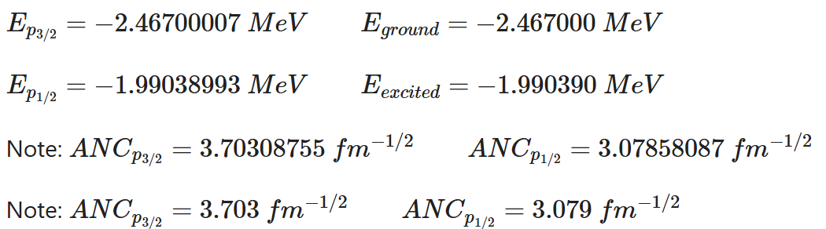
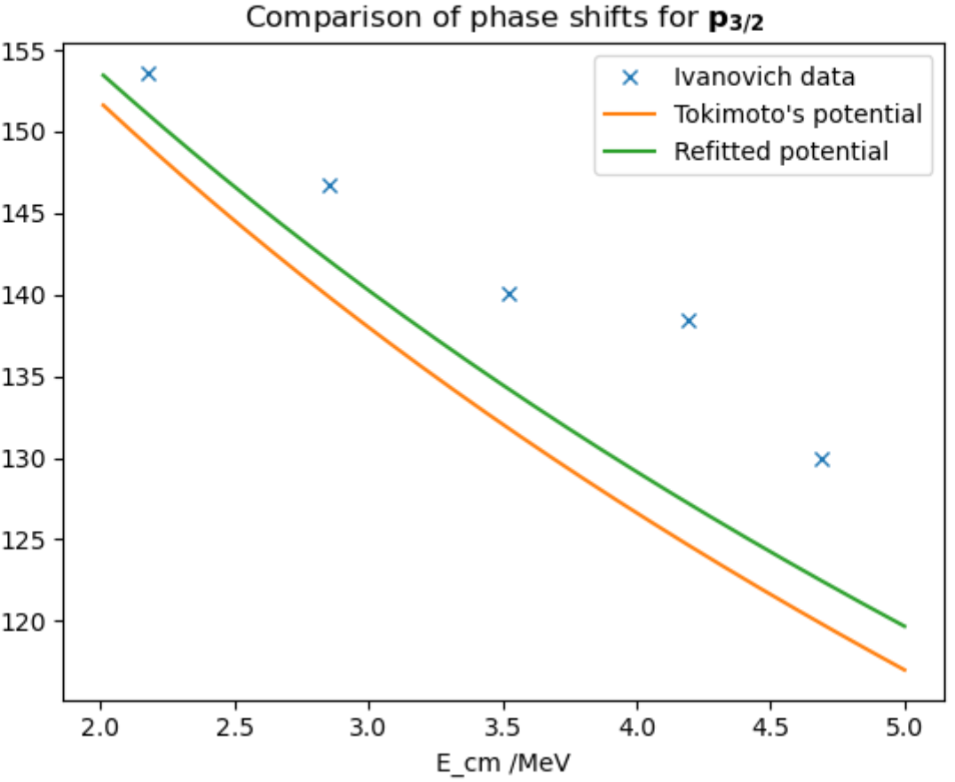
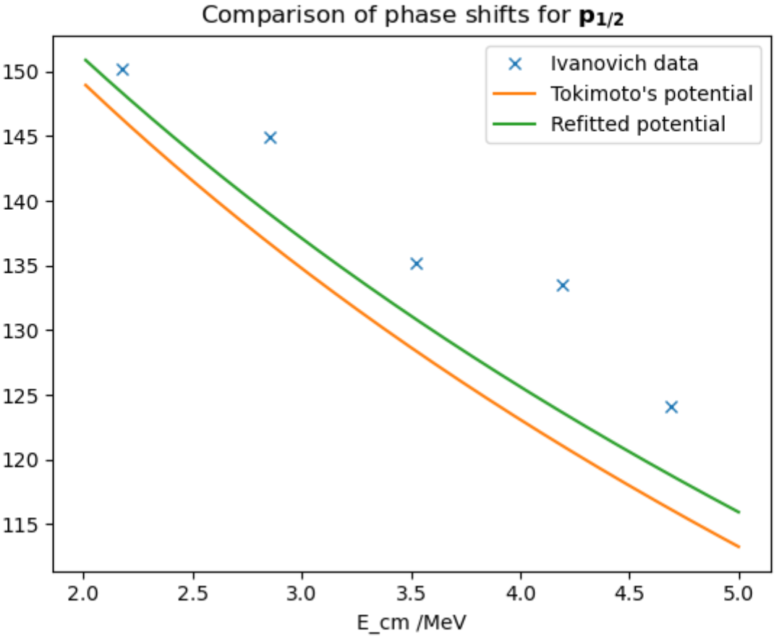
Correct by refitting Tokimoto’s model: p-waves

Slide 10
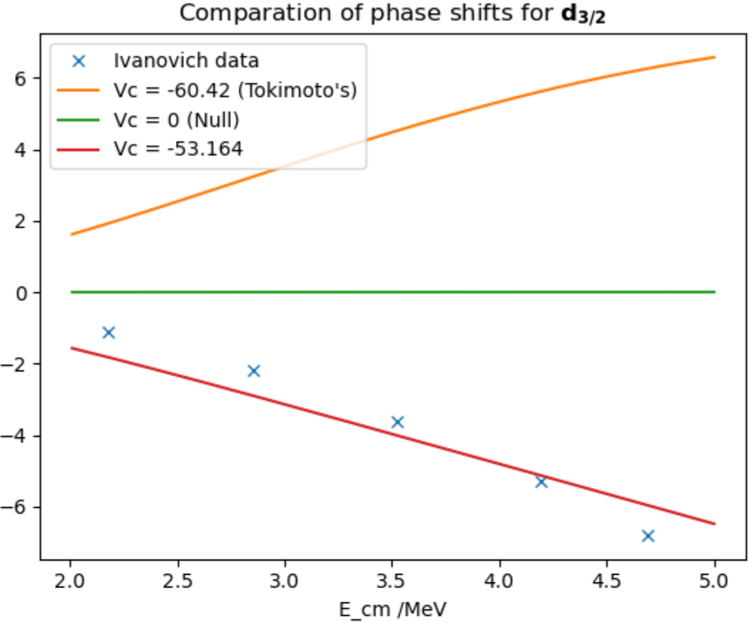
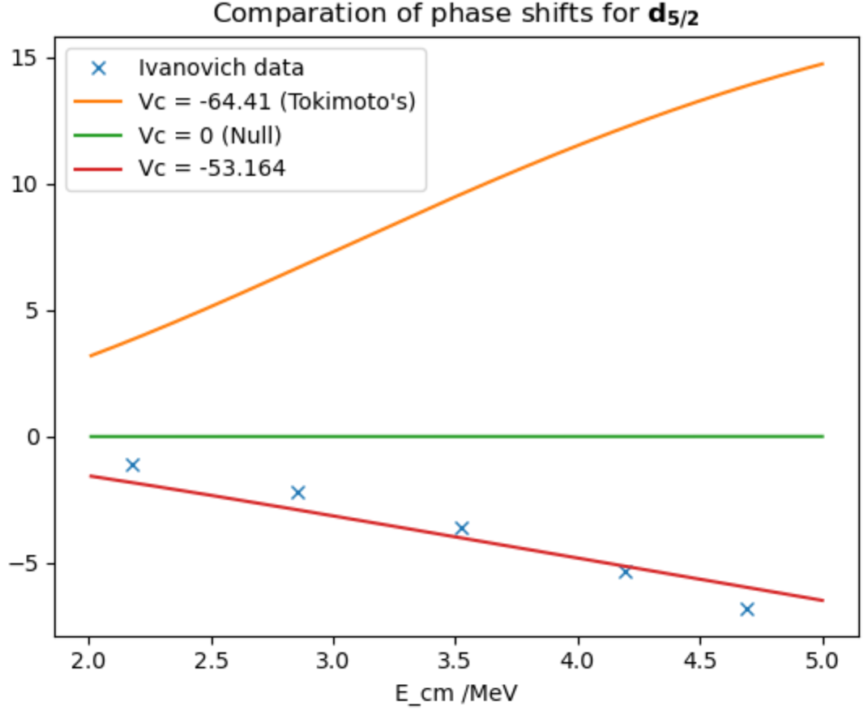
Correct by refitting Tokimoto’s model: d-waves

Slide 11
Correct by refitting Tokimoto’s model: conclusion
For s-wave and f-waves we will use Tokimoto’s parameters.
d-waves’ parameters refitted to phase-shift data.
p-waves’ parameters refitted to binding energy data:
→ Phase-shift is quite offsetted.
→ ANC doesn’t agree completely with measures. →
Knowing the true ANC,
we can scale cross-section
vs.
[ 2006, S.B. Igamov, R. Yarmukhamedov ]

Slide 12
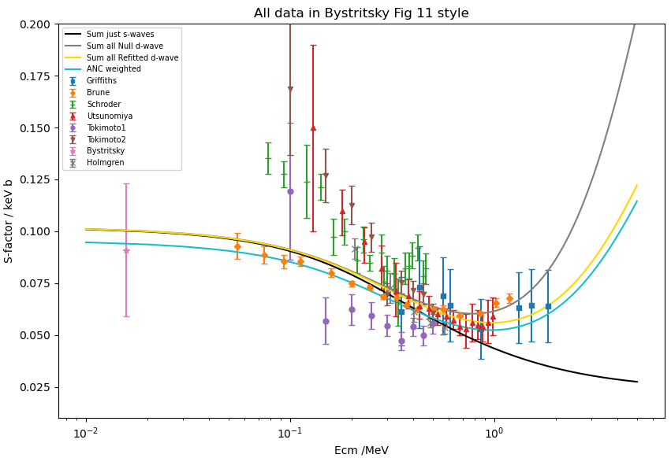

Slide 13
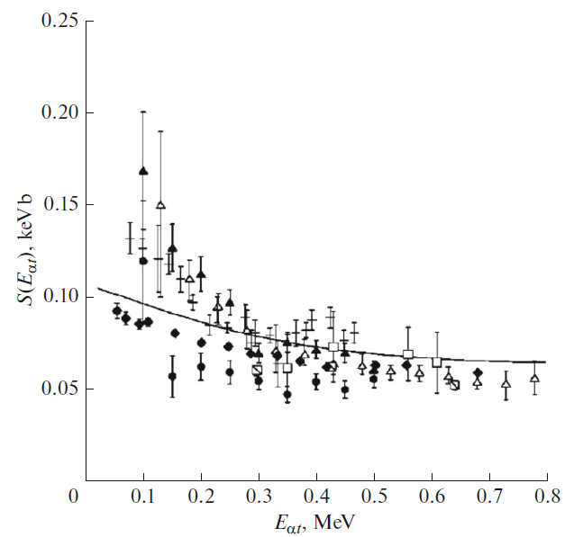
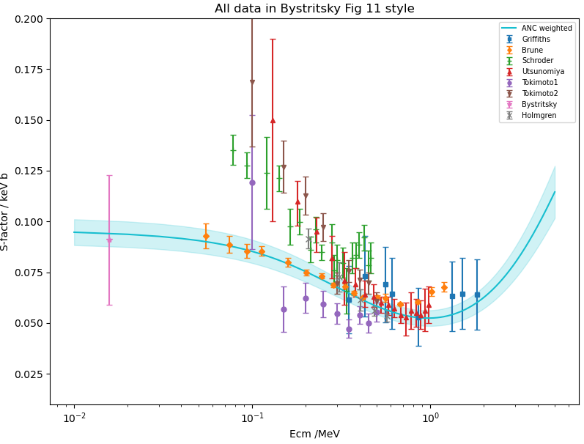
Final results and comparison
Fig. 1.
→ Solid line for Tokimoto’s results
[ 2016, V. M. Bystritsky, * ]

Slide 14
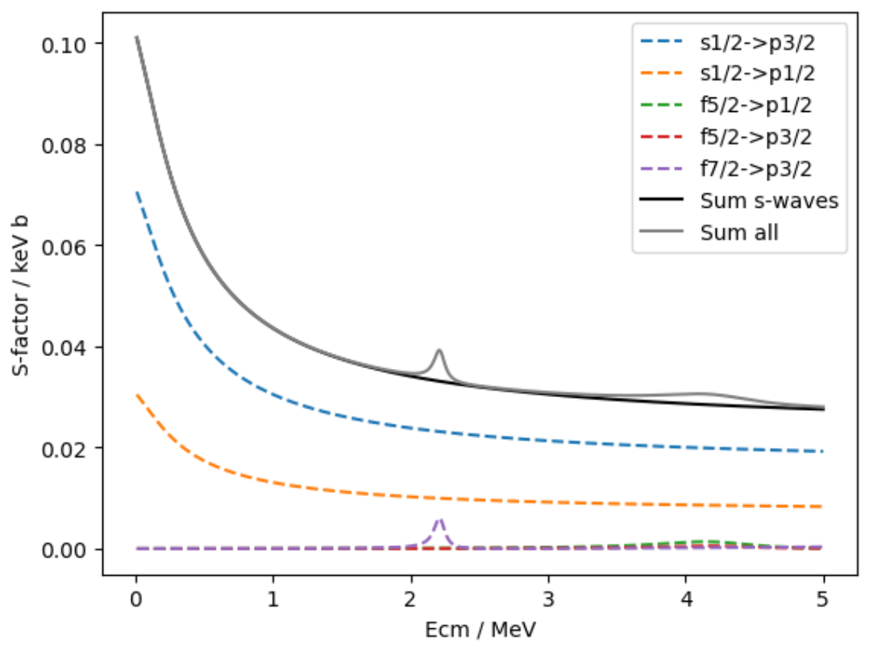
Significance of E2 transitions from f-waves
Using Tokimoto’s parameters
Conclusions:
Contributions no significant at all
Resonances quite well reproduced

Slide 15
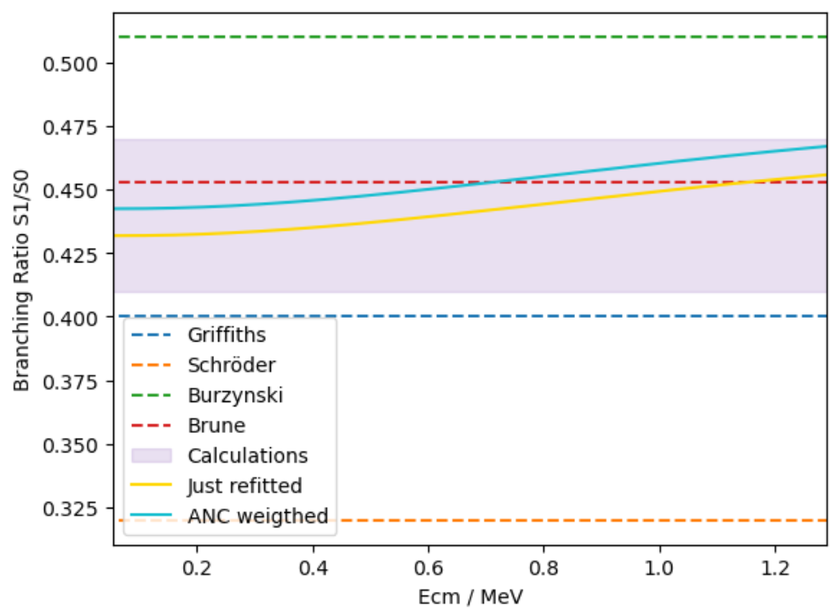
Investigate branching ratio, Igamov & Brune
In Brune’s paper there are several estimations of R = S1/S0
Griffiths R ~ 0.4
Schröder R = 0.32+-0.01
Burzynski R ~ 0.51
Calculations R in (0.41, 0.47)
T. Kajino, Nucl. Phys. A460, 559 (1986).
T. Altmeyer, E. Kolbe, T. Warmann, K. Langanke, and H. J. Assenbaum, Z. Phys. A 330, 277 (1988).
P. Mohr, H. Abele, R. Zwiebel, G. Staudt, H. Krauss, H. Oberhummer, A. Denker, J. W. Hammer, an G. Wolf, Phys. Rev. C 48, 1420 (1993)
· T. Kajino, G. J. Mathews, and K. Ikeda, Phys. Rev. C 40, 525 (1989)
Brune = 0.453

Slide 16
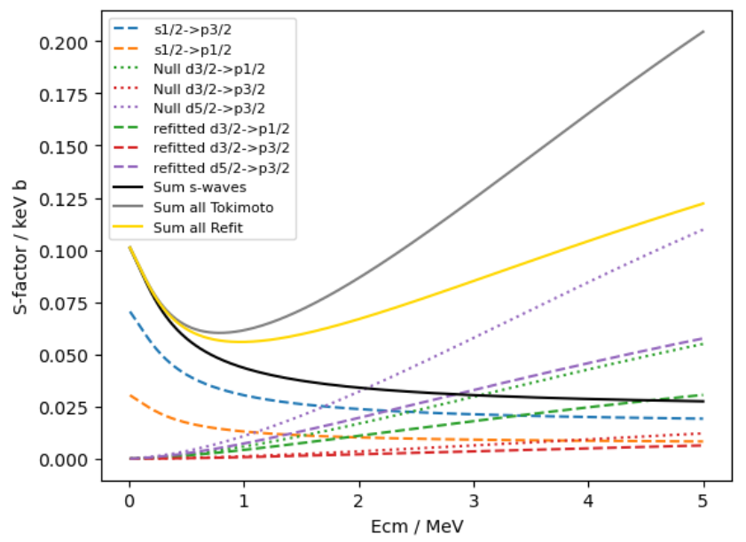
Contributions from d-waves
Refitted potential have smaller contributions for increasing energies than Tokimoto’s.
Low energy tails stay pretty similar.

Slide 17
References
G. M. Griffiths, J. B. Warren, R. A. Morrow, and P. J. Riley, “The T(α, γ)7Li reaction,” Can. J. Phys. 39, 1397 (1961).
S. Burzyński, K. Czerski, A. Marcinkowski, and P. Zupranski, “The 3H(α, γ)7Li reaction in the energy range from 0.7 to 2.0 MeV,” Nucl. Phys. A 473, 179 (1987).
U. Schroder et al., “Astrophysical S factor of 3H(α, γ) 7Li,” Phys. Lett. B 192, 55 (1987).
H. Utsunomiya et al., Phys. Lett. B 211, 24 (1988); Nucl. Phys. A 511, 379 (1990); Phys. Rev. Lett. 65, 847 (1990); Phys. Rev. Lett. 69, 863(E) (1992).
C. R. Brune, R. W. Kavanagh, and C. Rolfs, “3H(α, γ)7Li reaction at low energies” Phys. Rev. C 50, 2205 (1994).
Y. Tokimoto, H. Utsunomiya, T. Yamagata, et al., “Coulomb breakup of 7Li for nuclear astrophysics,” Phys. Rev. C 63, 035801 (2001).
V.M. Bystritsky, G.N. Dudkin, E.G. Emets, A.R. Krylov, et al., “Astrophysical S-factor of T(4He,g)7Li reaction at Ecm=15.7 keV” Physics of Particles and Nuclei Letters, 2017, Vol. 14, No. 4
H.D. Holmgren, R.L. Johnston, “3H(α, γ)7Li and 3He(α, γ)7Be Reactions” Phys. Rev. Vol. 113 n. 6 (1959)

